Slide 1
SHEA Spring 2024 Data Visualization Demo
Matthew Ziegler

Slide 2
R Markdown
This is an R Markdown presentation. Markdown is a simple formatting syntax for authoring HTML, PDF, and MS Word documents. For more details on using R Markdown see http://rmarkdown.rstudio.com.
When you click the Knit button a document will be generated that includes both content as well as the output of any embedded R code chunks within the document.

Slide 3
Overview
A rapid overview of R
Importing and manipulating data
Visualizing data

Slide 4
R Introduction
R is a programming language useful for
data
data visualization
statistics
Typically used with a software interface
RStudio
VScode
Community derived “packages”
Resources: R for Data Science https://r4ds.had.co.nz

Slide 5
R Introduction
Why use a code-based approach to data manipulation? -Reproducible -Easy to share -Infinitely modifiable

Slide 6
R Introduction
-Download and install R -Download and install R Studio (or alternative) -Run scripts -R Script -R Markdown -Version control and collaboration via Github

Slide 7
Getting Started
-let’s load some packages -“tidyverse” is an open source collection of packages for working with data -“dplyr” is a set of functions for data manipulation -“ggplot2” is a system for creating graphics
library(dplyr) library(ggplot2) library(gt)

Slide 8
Piping Data
-Imagine your data is water -Through a series of pipes ( %>% ) you can -transform your data -feed data to generate different products
data %>% new_data %>% tables data %>% different_data %>% figures

Slide 9
Loading our Data
-Loading example data from CDC HAIC-Viz
dat_cdiff <- read.csv("/Users/mattz/Documents/GitHub/shea24_demo/HAICViz_-_CDI_20240214.csv") %>% janitor::clean_names() %>% filter(topic == "Case rates (cases per 100,000)", series == "Community-associated" | series == "Healthcare-associated")
head(dat_cdiff)
## year_name topic view_by grouping ## 1 2011 Case rates (cases per 100,000) Total Epi Class ## 2 2012 Case rates (cases per 100,000) Total Epi Class ## 3 2013 Case rates (cases per 100,000) Total Epi Class ## 4 2014 Case rates (cases per 100,000) Total Epi Class ## 5 2015 Case rates (cases per 100,000) Total Epi Class ## 6 2016 Case rates (cases per 100,000) Total Epi Class ## series value ## 1 Community-associated 48.16 ## 2 Community-associated 52.88 ## 3 Community-associated 55.75 ## 4 Community-associated 57.83 ## 5 Community-associated 65.81 ## 6 Community-associated 67.20

Slide 10
Let’s do a simple graph
-start with your data -pipe your data to ggplot - ggpplot() -define the aesthetics either globally or individually by plot - aes() -add your plots and labels - geom_line() + labs()
dat_cdiff_line_plot <- dat_cdiff %>% ggplot(aes(x = as.factor(year_name), y = value, group = series)) + geom_line(aes(linetype = series)) + labs(title = "Cases by year", y = "CDI cases per 1000 individuals", x = "Year")

Slide 11
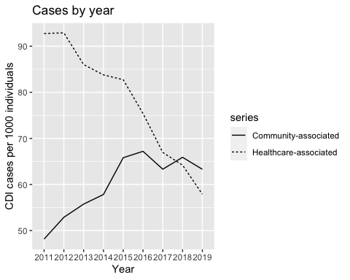
Let’s do a simple graph

Slide 12
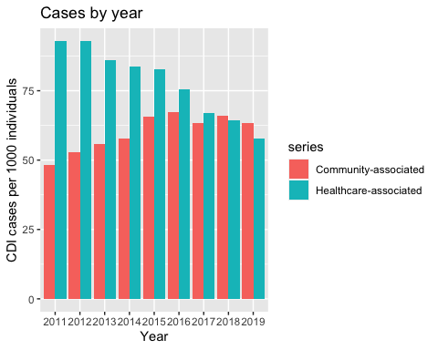
Let’s do a simple graph
-Don’t like lines? - https://ggplot2.tidyverse.org/reference/
dat_cdiff %>% ggplot(aes(x = as.factor(year_name), y = value, fill = series)) + geom_col(position = "dodge") + labs(title = "Cases by year", y = "CDI cases per 1000 individuals", x = "Year")

Slide 13
A little more complicated
library(tidyr)
dat_cdiff_cat_plot <- read.csv("/Users/mattz/Documents/GitHub/shea24_demo/HAICViz_-_CDI_20240214.csv") %>% janitor::clean_names() %>% filter(topic == "Case rates (cases per 100,000)") %>% mutate(cat = case_when(grepl("HA|CA", series) == TRUE & grepl("years", series) == TRUE ~ "age", grepl("Male|Female", series) == TRUE & grepl("HA|CA", series) == TRUE ~ "sex", grepl("White|Non-white", series) == TRUE & grepl("HA|CA", series) == TRUE ~ "race")) %>% filter(!is.na(cat)) %>% separate(series, into = c("category", "group"), sep = " - ") %>% ggplot(aes(x = as.factor(year_name), y = value, group = interaction(group, category), linetype = category, col = group, )) + geom_line(lwd = 1) + theme_minimal() + theme(axis.text.x = element_text(angle = 75, vjust = 0, hjust = 0)) + facet_wrap(vars(cat)) + labs(title = "C.difficile Infection by Year", y = "Case rates (cases per 100,000)", x = "Year")

Slide 14
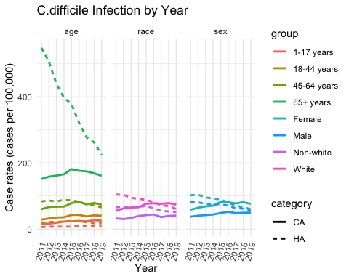
A little more complicated
dat_cdiff_cat_plot

Slide 15
Highlighting and annotating
library(gghighlight)
dat_mdrgn <- read.csv("/Users/mattz/Documents/GitHub/shea24_demo/HAICViz_-_MuGSI_20240330.csv") %>% janitor::clean_names() %>% mutate(keep = case_when(viewby == "Organism" & series != "All cases" ~ 1, organism == "CRAB" & viewby == "All cases" & topic == "Case Rates" ~ 1, TRUE ~ 0)) %>% filter(keep == 1) %>% mutate(series = ifelse(organism == "CRAB", "Acinetobacter baumanii", series))
dat_mdrgn_plot <- dat_mdrgn %>% ggplot(aes(x = as.factor(year_name), y = value, group = series)) + geom_line(aes(linetype = series)) + theme(axis.text.x = element_text(angle = 75, vjust = 0, hjust = 0)) + labs(title = "Cases by year - Carbapenem-Resistant GNB", y = "Cases per 1000 individuals", x = "Year") + gghighlight(series == "Acinetobacter baumanii") + theme_minimal()

Slide 16
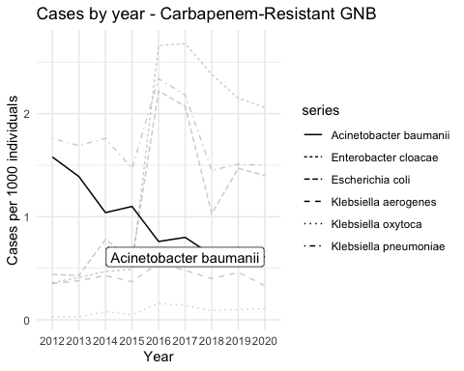

Slide 17
Animated figures
library(magick) library(gganimate) library(maps) library(tidyr)
respi <- read.csv("/Users/mattz/Documents/GitHub/shea24_demo/Outpatient_Respiratory_Illness_Activity_Map_20240401.csv") %>% janitor::clean_names() %>% mutate(region = tolower(state)) %>% separate(activity_level, into = c(NA, "level"), sep = " ") %>% mutate(level = as.numeric(level)) %>% filter(season == "2022-2023") states <- map_data("state")
region_dat_respi <- left_join(states, respi, by = "region")
gif_a <- region_dat_respi %>% ggplot(., aes(long, lat, group = group)) + geom_polygon(aes(fill = level), colour = alpha("white", 1/2), size = 0.05) + geom_polygon(data = states, colour = "black", fill = NA) + scale_fill_gradientn(colours = terrain.colors(6)) + theme_void() + transition_time(week) + labs(title = "Respiratory Infection Activity 22-23 Season: Week {frame_time}") + theme_minimal() gif_a <- animate(gif_a, width = 700, height = 480)

Slide 18
Animate
gif_b <- region_dat_respi %>% # filter(!is.na(value)) %>% ggplot(data = ., aes(y = level)) + geom_boxplot() + labs(x = "", title = "National Value") + theme(axis.text.x = element_blank()) + transition_time(week) # enter_fade() + exit_shrink() + ease_aes('sine-in-out') gif_b <- animate(gif_b, width = 600, height = 480)

Slide 19
Animate
a_mgif <- image_read(gif_a) b_mgif <- image_read(gif_b) new_gif <- image_append(c(a_mgif[1], b_mgif[1])) for (i in 1:95) { combined <- image_append(c(a_mgif[i], b_mgif[i])) new_gif <- c(new_gif, combined) }

Slide 20
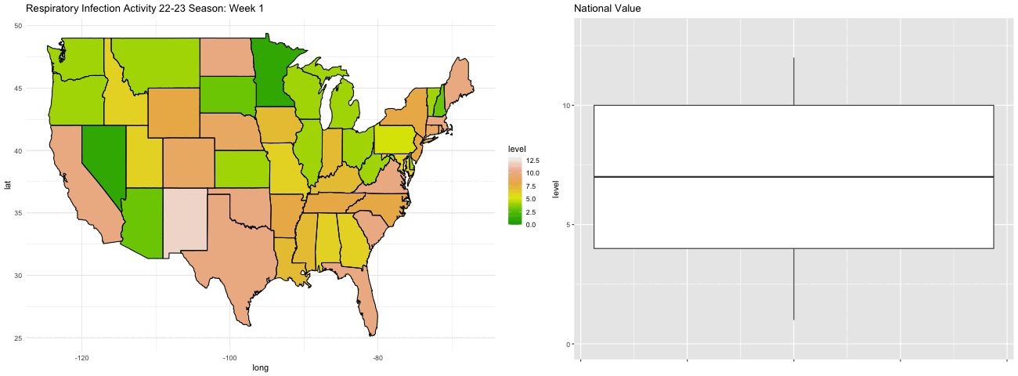

Slide 21
Plotting Model Output
library(gtsummary) library(marginaleffects) latitude_by_states <- states %>% group_by(region) %>% summarise(mean_lat = mean(lat))

Slide 22
Plotting Model Output
vaccination <- read.csv("/Users/mattz/Documents/GitHub/shea24_demo/Vaccination_Coverage_among_Health_Care_Personnel_20240401.csv") %>% janitor::clean_names() %>% mutate(year = as.numeric(substr(season, 1, 4))) %>% mutate(region = tolower(geography)) %>% left_join(latitude_by_states, by = "region") %>% rename(latitude = mean_lat) %>% filter(personnel_type != "All Health Care Personnel")

Slide 23
Plotting Model Output
model <- lm(estimate ~ year + latitude + personnel_type, dat = vaccination)

Slide 24
Plotting Model Output
tbl_regression(model)

Slide 25
Plotting Model Output
plot_predictions(model, condition = "year") + labs(y = "Estimated Proportion: Vaccine Compliance", x = "Year", title = "Estimated Vaccine Compliance by Year") + theme_minimal()

Slide 26
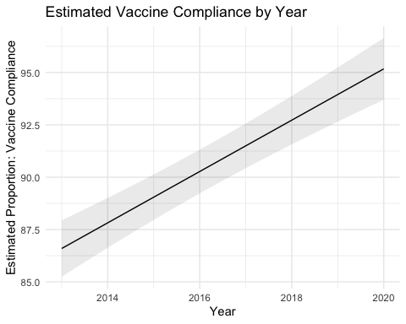
Plotting Model Output

Slide 27
What Else?
-Tons of styles, themes, fonts -Combine different plots with patchwork -Creae interactive graphs, hover over to reveal specific information (ggplotly, shiny) -Choose a color pallet from the Metropolitan Museum of Art (metbrewer)

Slide 28
Conclusions
-Code-based data manipulations and visualization is highly flexible -Tons of great free-to-use, open-source packages

Slide 29
Resources
-Start with the basics (https://r4ds.had.co.nz) -If you have a problem, someone has probably figured it out (https://stackoverflow.com) -Lots of great videos and lectures available - -This presentation is available as an RMD file (R MarkDown File)

Slide 30
Citations
-https://www.cdc.gov/hai/eip/haicviz.html

